Slide 1
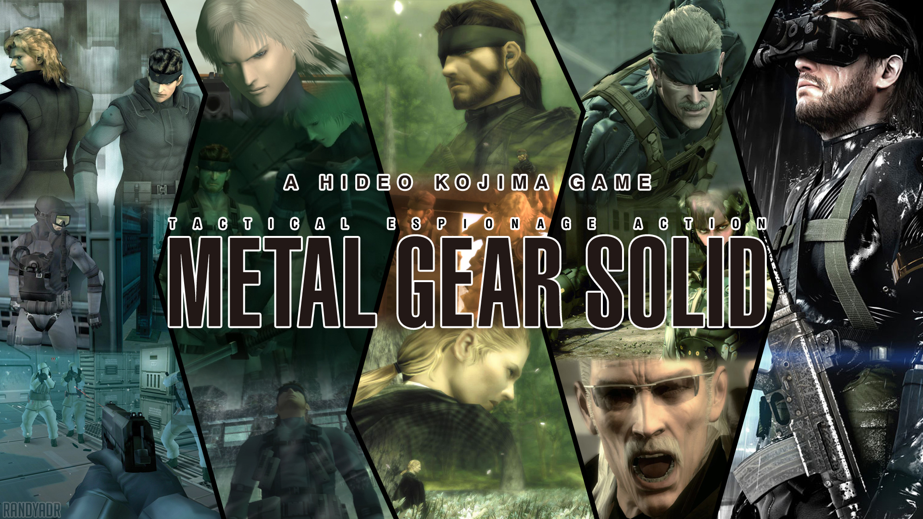

Slide 2
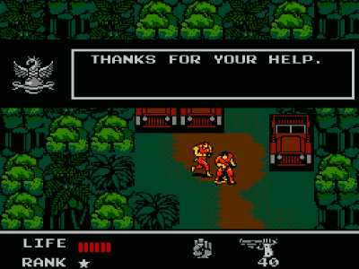
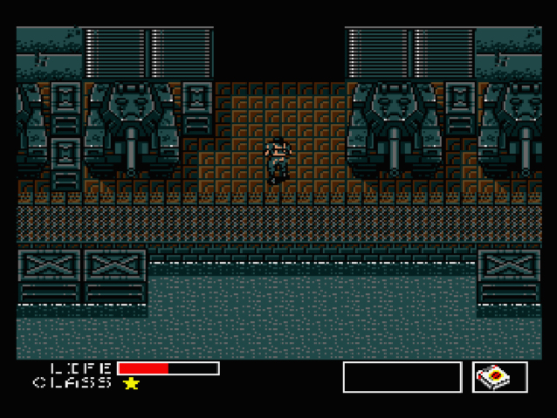
METAL GEAR 1987
METAL GEAR 2 : SOLID SNAKE (1990)

Slide 3
move horzontaly and verticaly
Corpse disapperance
No place to hide
No concept of distance

Slide 4
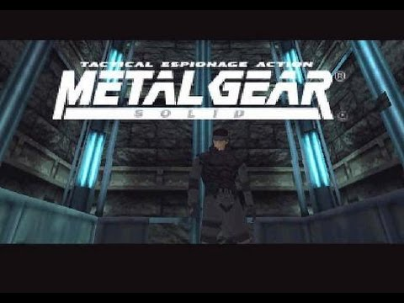

Slide 5
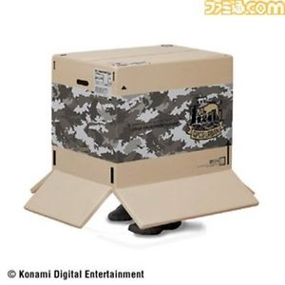
move horzontaly, verticaly, diagonally and climb height
Target everywhere around the caracter
Strangle enemies
Watch arround you at the first person vew
Change his position
Hide himself in a box

Slide 6
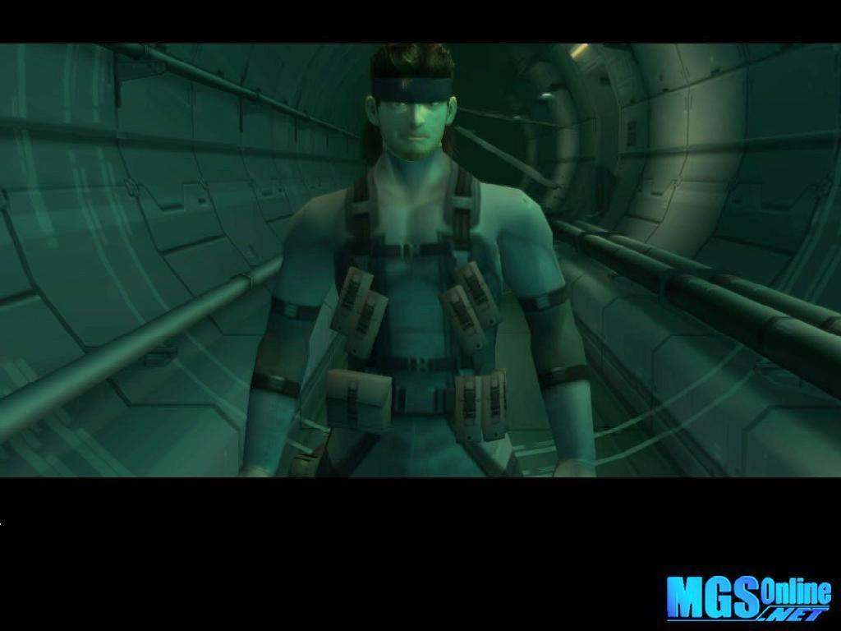

METAL GEAR SOLID 2
Sons of Liberty (2001)
METAL GEAR SOLID 3
SNAKE EATER (2004)

Slide 7
Corps stop to disapper
Climb more things
Target with the first person vew
Roll in the front
Concept of camouflage (MGS 3)

Slide 8
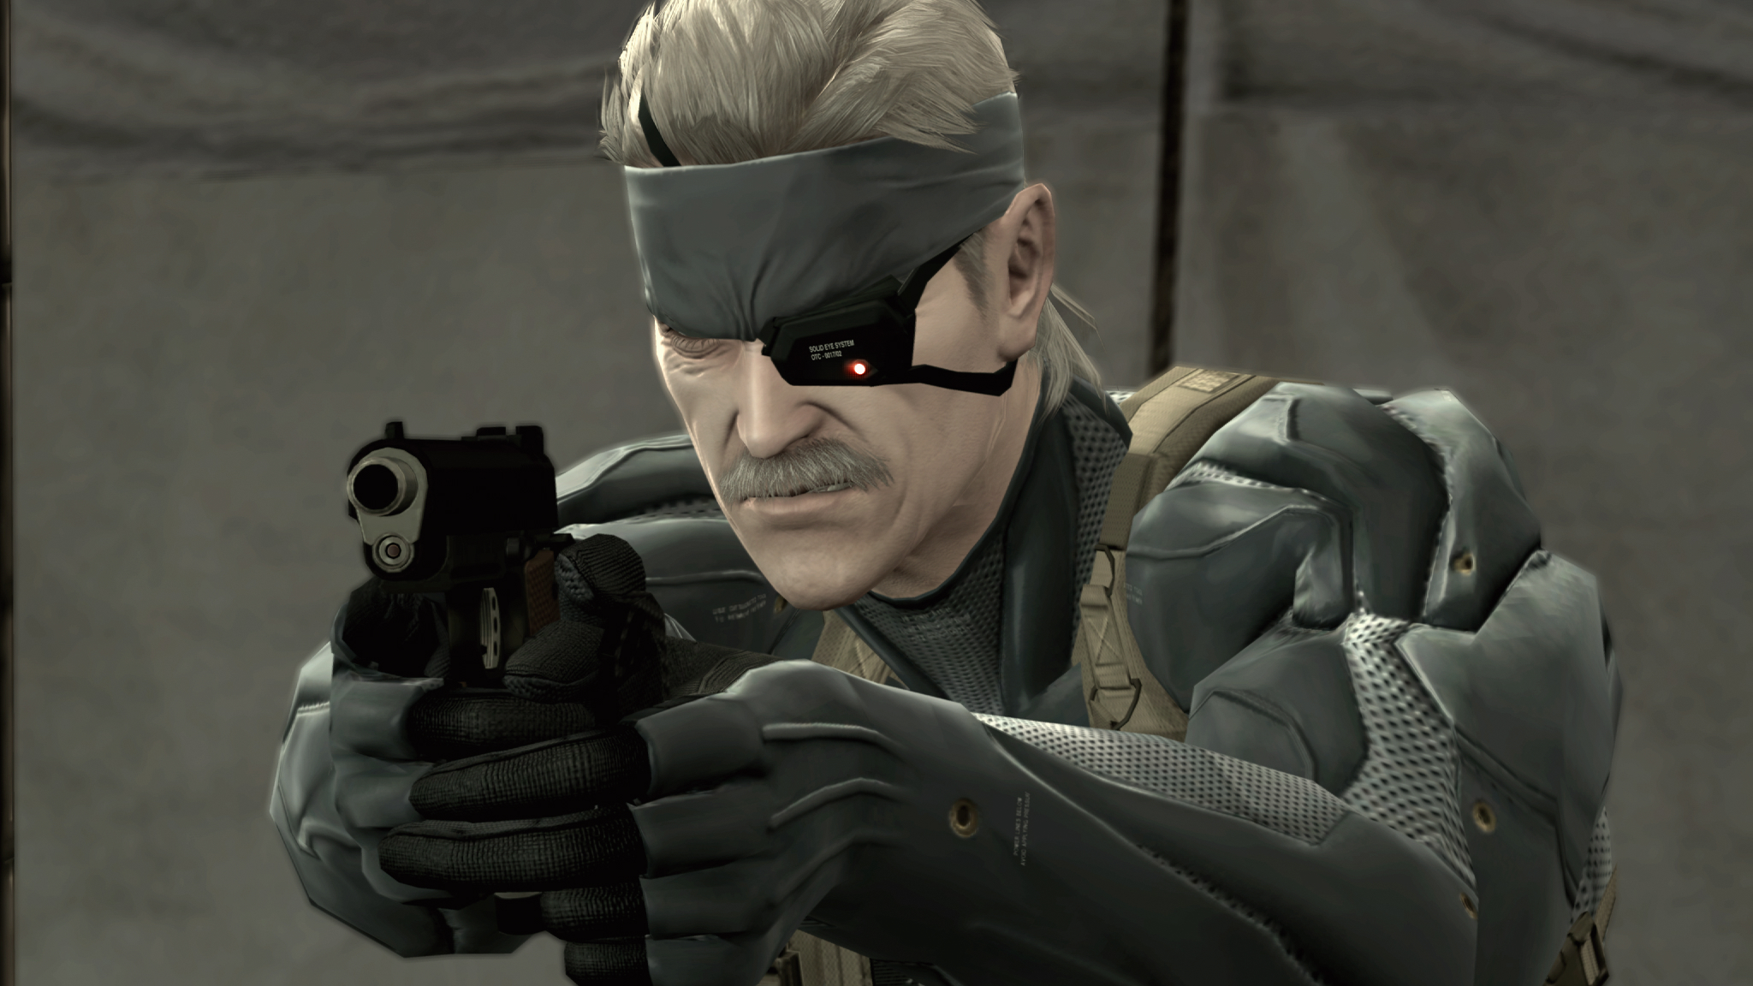
METAL GEAR SOLID 4 GUNS OF THE PATRIOTS (2008)

Slide 9
A third position
Target at the third person vew
Management of the mental state
Items seller
PAUSE A CUTSCENE

Slide 10
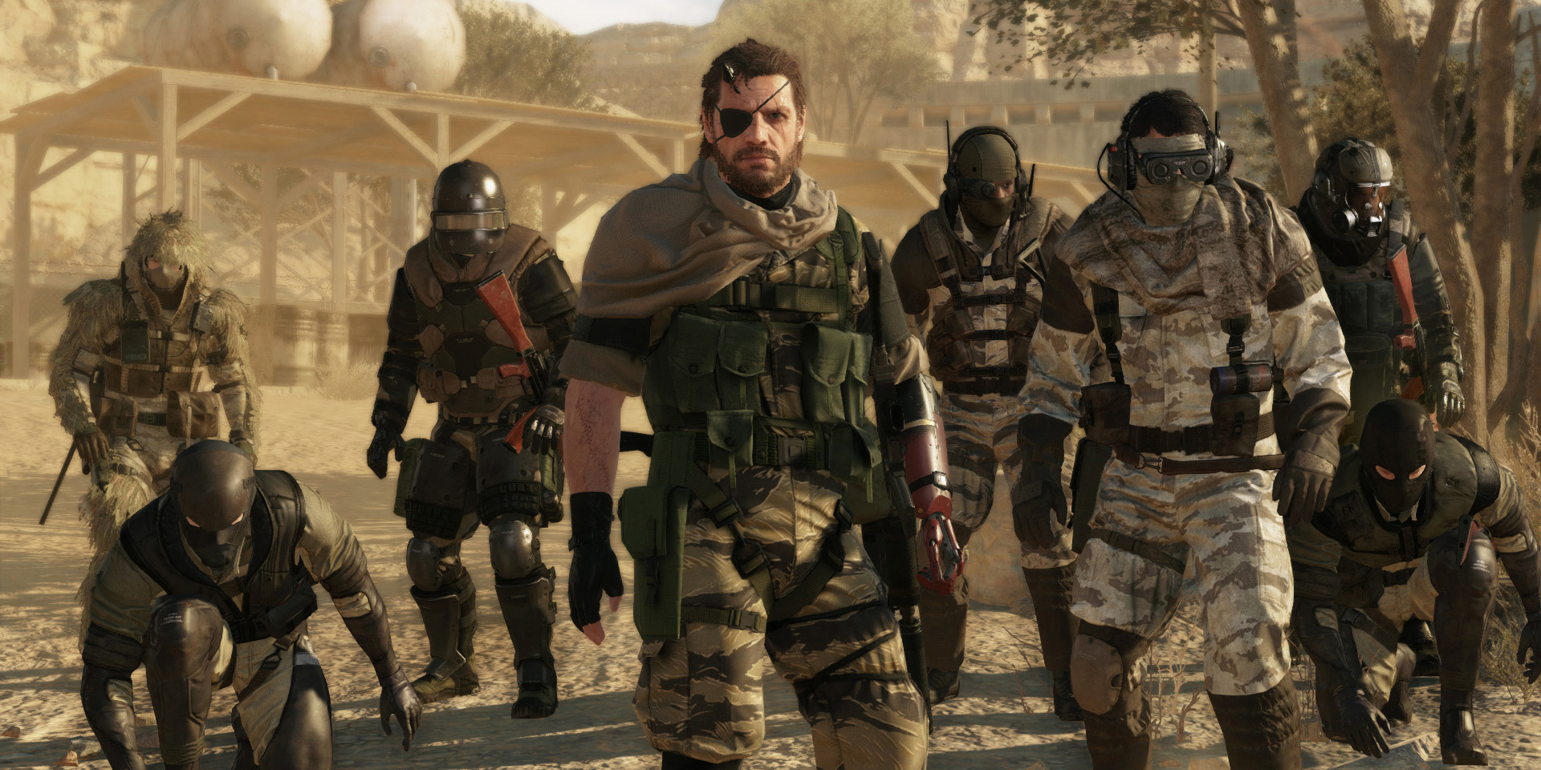
METAL GEAR SOLID 5 THE PHANTOM PAIN (2015)

Slide 11
Open World
Management of a base, his employees, and his resouces
Use vehicules
Capture Ennemies and annimals
The « I Droïd »

Slide 12
Conclusion

Slide 13

THANK YOU !!!

